Slide 1

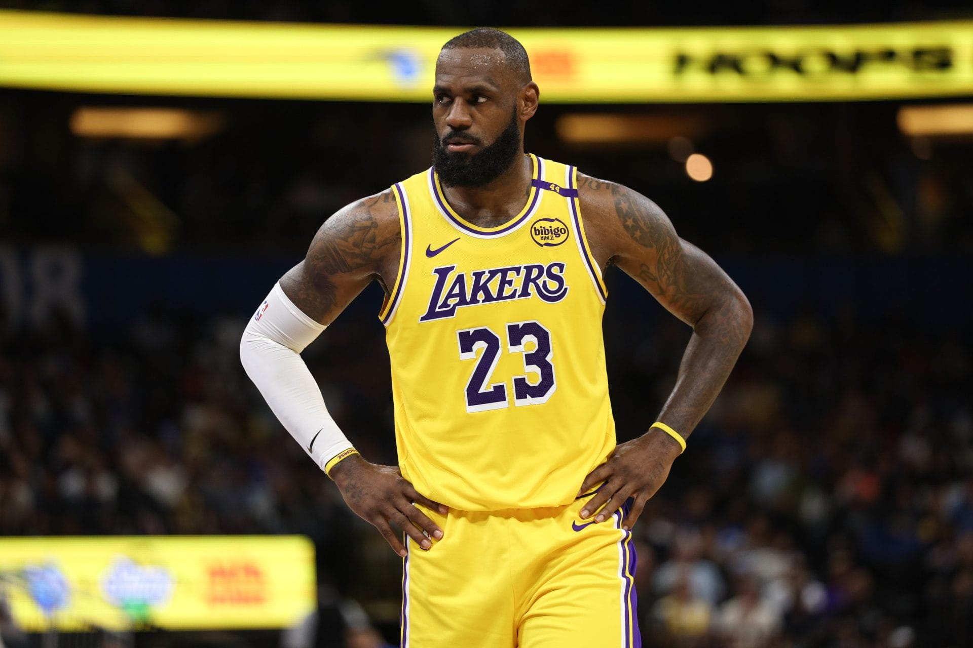
Have the NBA player roles changed between 1993-94 and 2023-24 seasons?
Oktay Taha Ates, 2110427

Slide 2
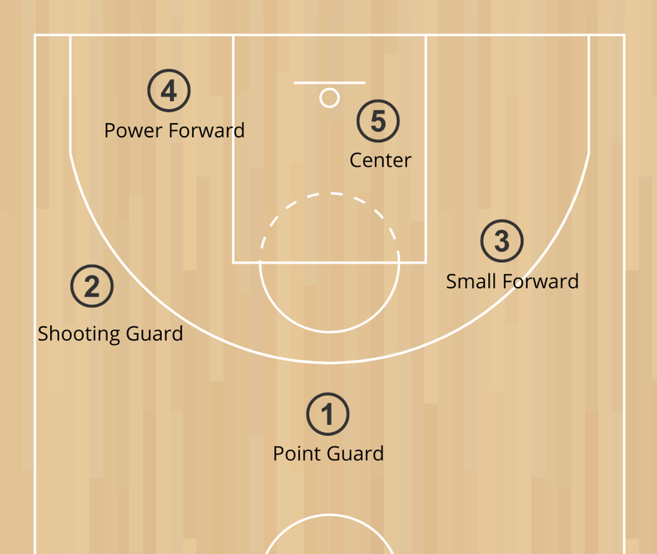
Why this Question
This is an ongoing topic in the NBA community, have player roles, tendencies and skills changed across different positions?
The reason for this question is pretty standard, we see players shooting more 3s and centers becoming more and more technically skilled, especially after mid 2010s.
But is this backed up by actual data?

Slide 3
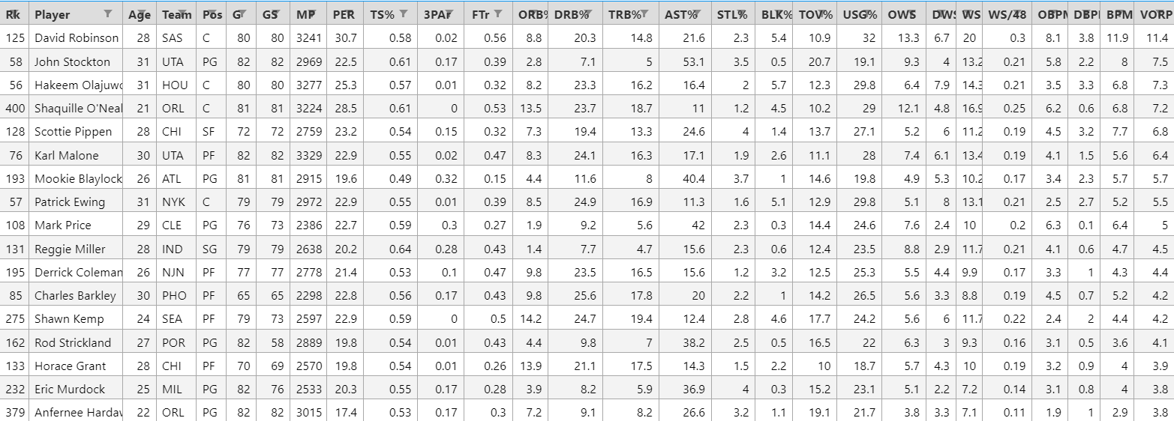
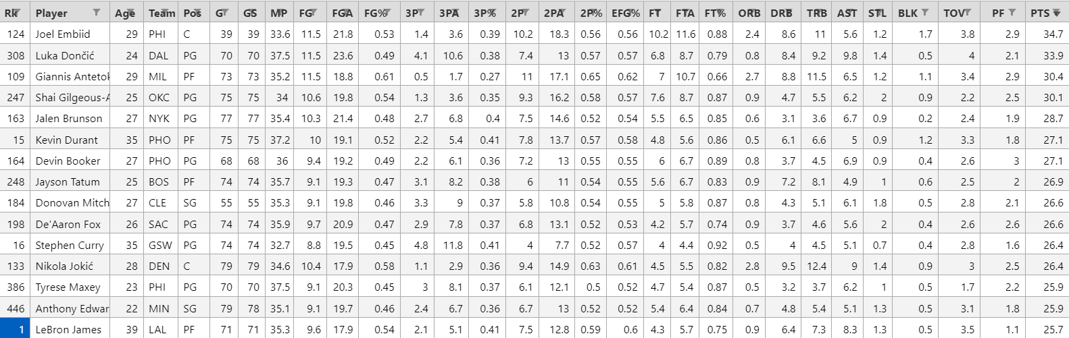
The Dataset
All the data is pulled manually from Basketball Reference, a basketball statistics page. (https://www.basketball-reference.com)
Dataset contains a total of 977 players from 93-94 and 23-24 seasons.
Per Game Stats
Advanced Stats

Slide 4
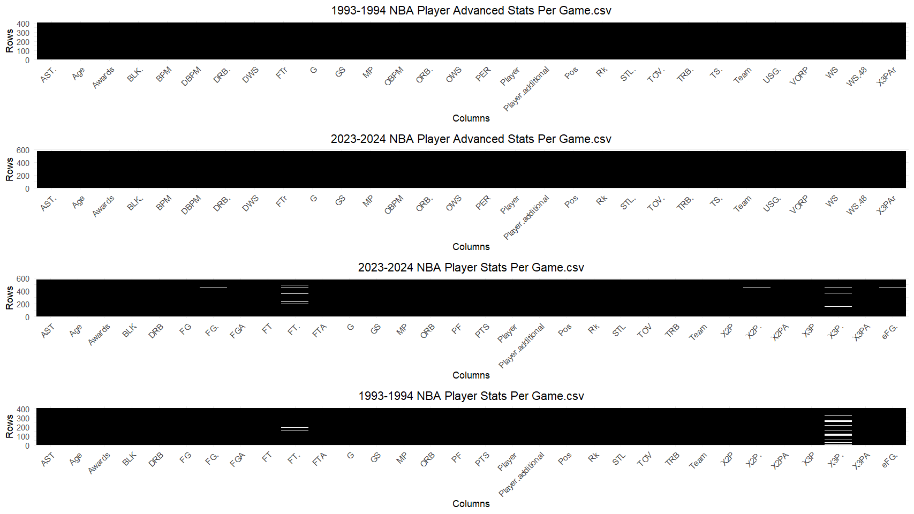
Missing Value Analysis
Players containing missing values were set to 0, since the missing values were all from percentage related columns.
Total: 16
Percentage: 0,13%
Total: 30
Percentage: 0,17%
Total: 102
Percentage: 0,56%
Total: 105
Percentage: 0,81%

Slide 5

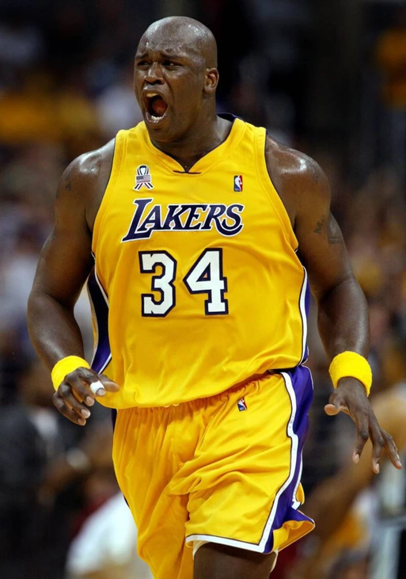
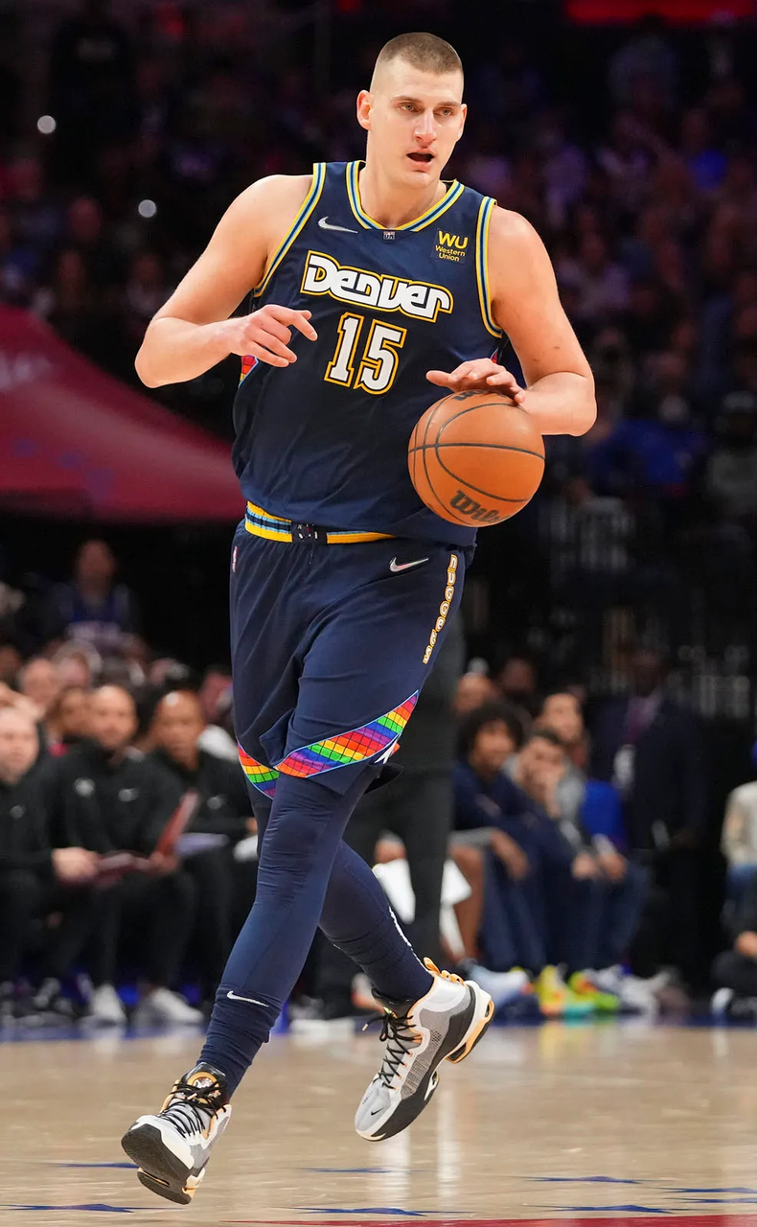
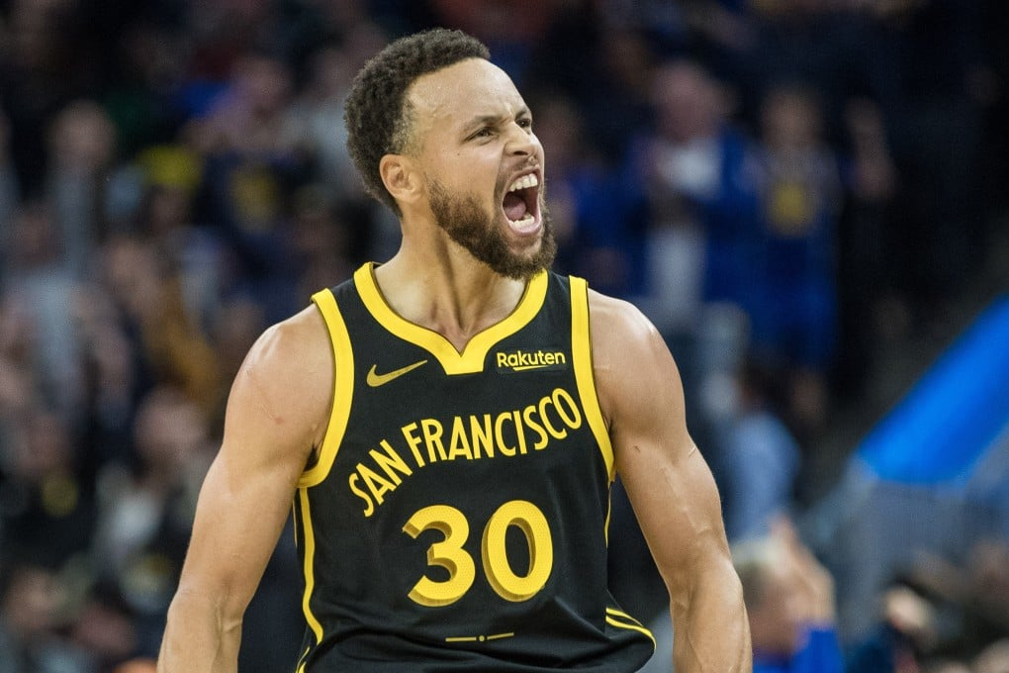
Let’s Look at Some Player Archetypes

Slide 6
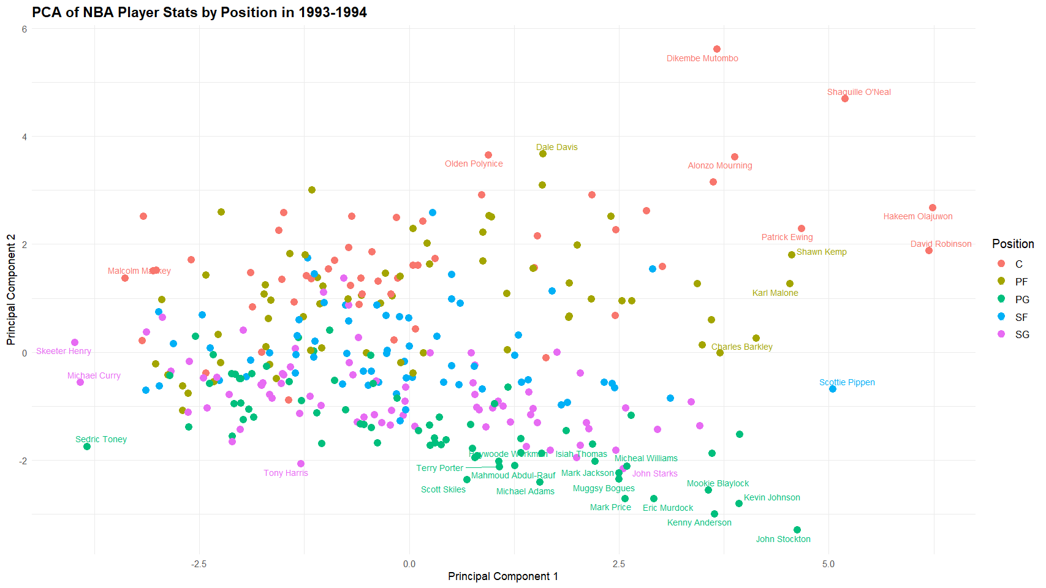




PCA of NBA Player Statistics in 93'
Standard clusterings for point guards and power forwards.
Two main groups for centers.
+BLK, +TRB,-3P%, -FT%,
+PTS, +AST,+TRB,
+STL

Slide 7
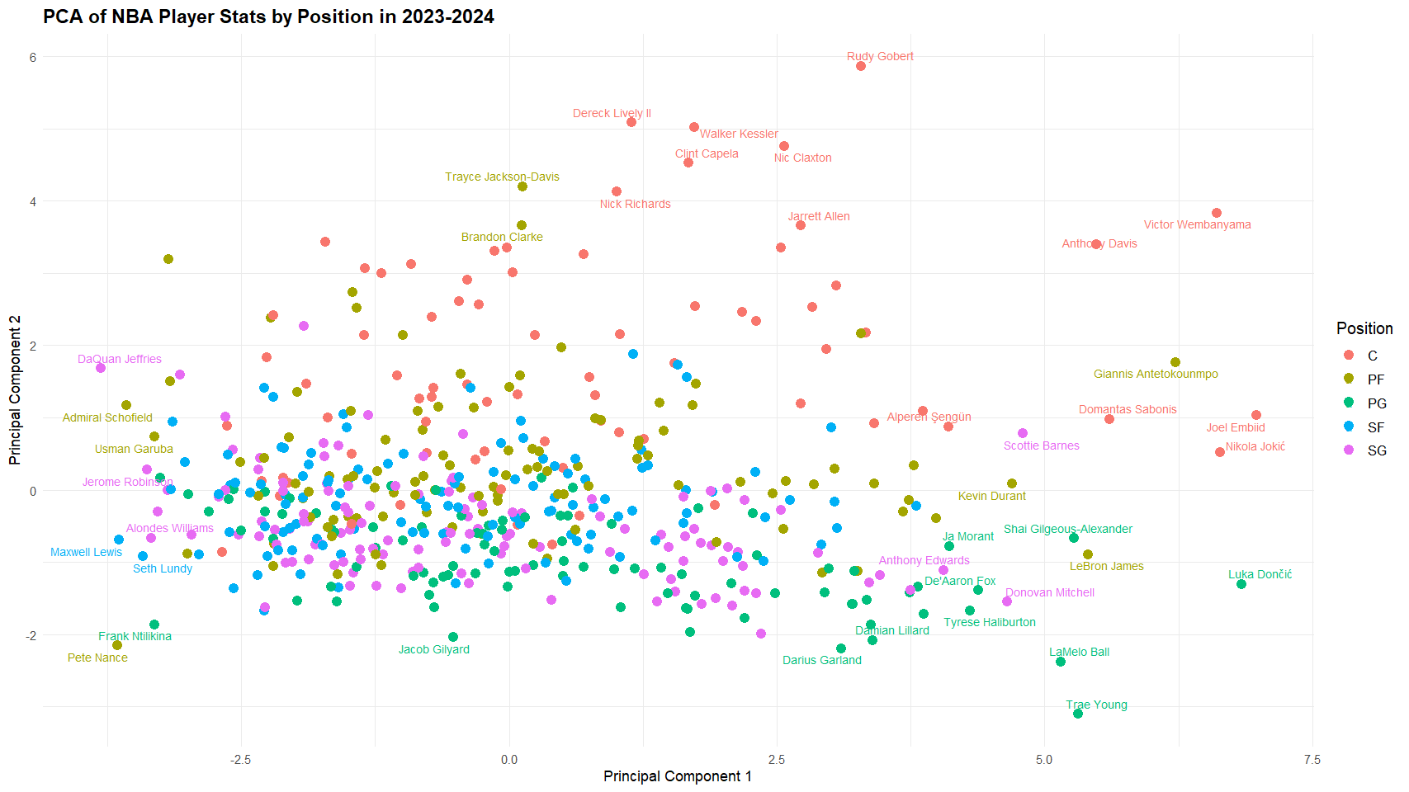



PCA of NBA Player Statistics in 23'
Centers are more diverse (3 different clusters)
Power forwards, shooting guards and shooting forwards all in one cluster.
+BLK, +TRB,-3P%, -FT%,
+PTS, +AST,+TRB,
+STL

Slide 8
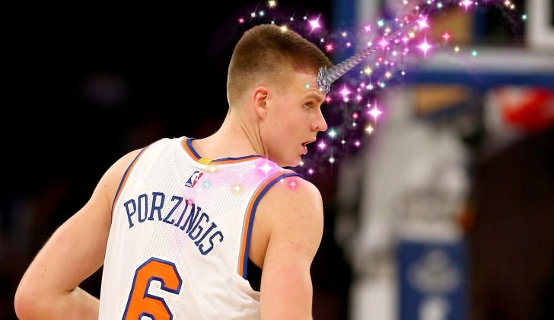
Are These Clusterings Some “Unicorns” or is There a General Tendency?

Slide 9
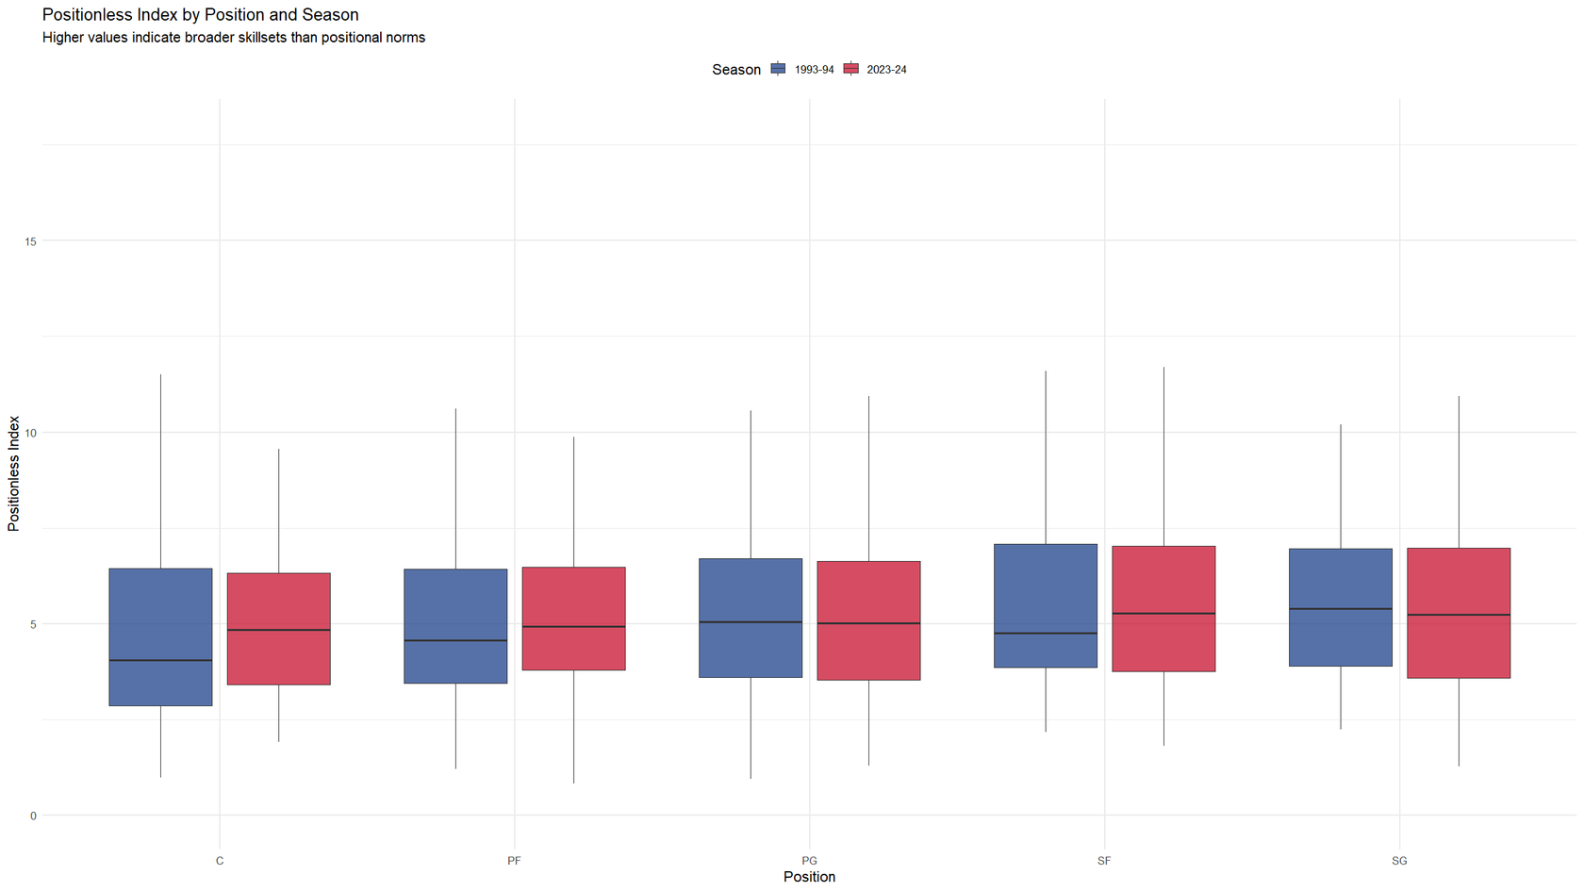
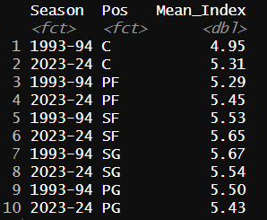
“Positionless” Index
Positionless Index combines z-scores of AST, STL, 3PAr, USG%, TOV, TRB, and BLK to measure how much a player deviates from typical positional roles.

Slide 10
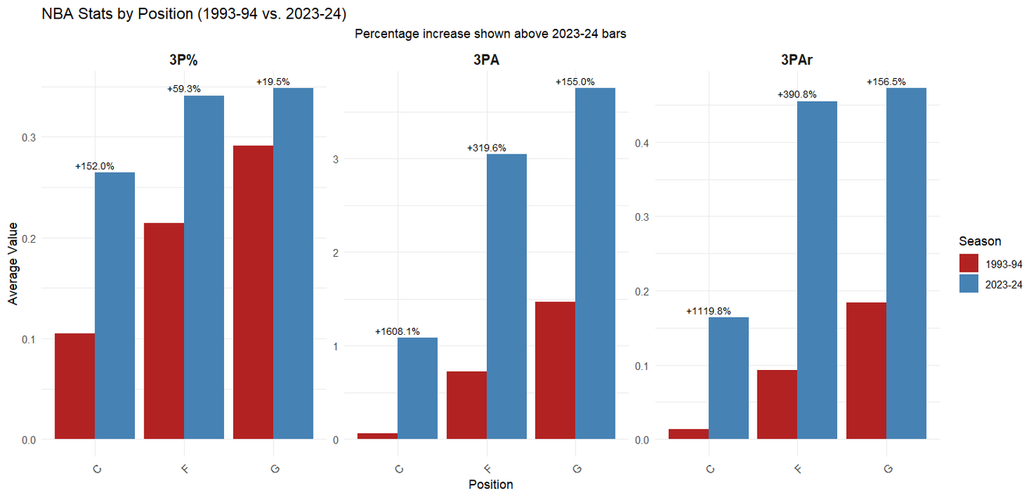
Statistic Averages of NBA players
3PA (3P Attempts) and 3P% (3P Percentage) increased!
3PAr (3P Attempt Rate) increased!
Average assists increased for centers and forwards

Slide 11
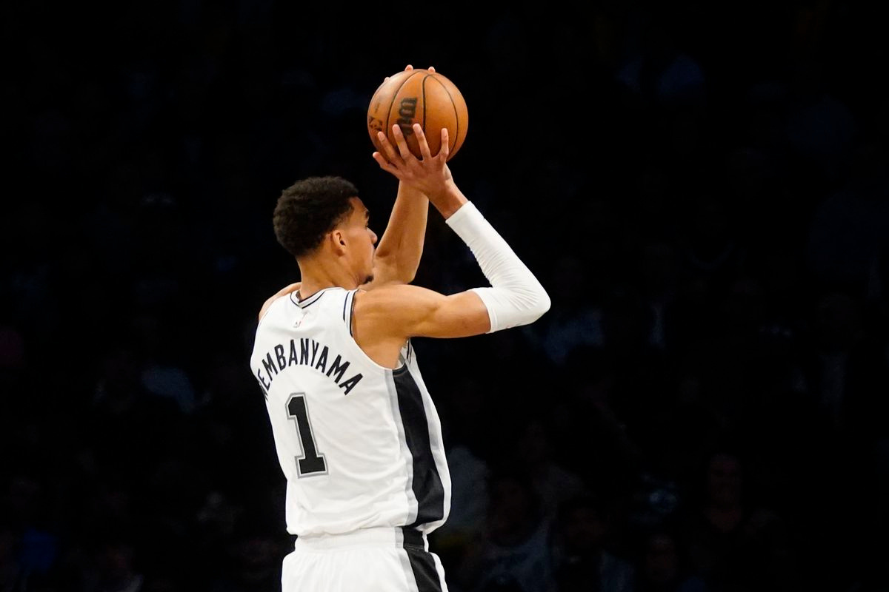
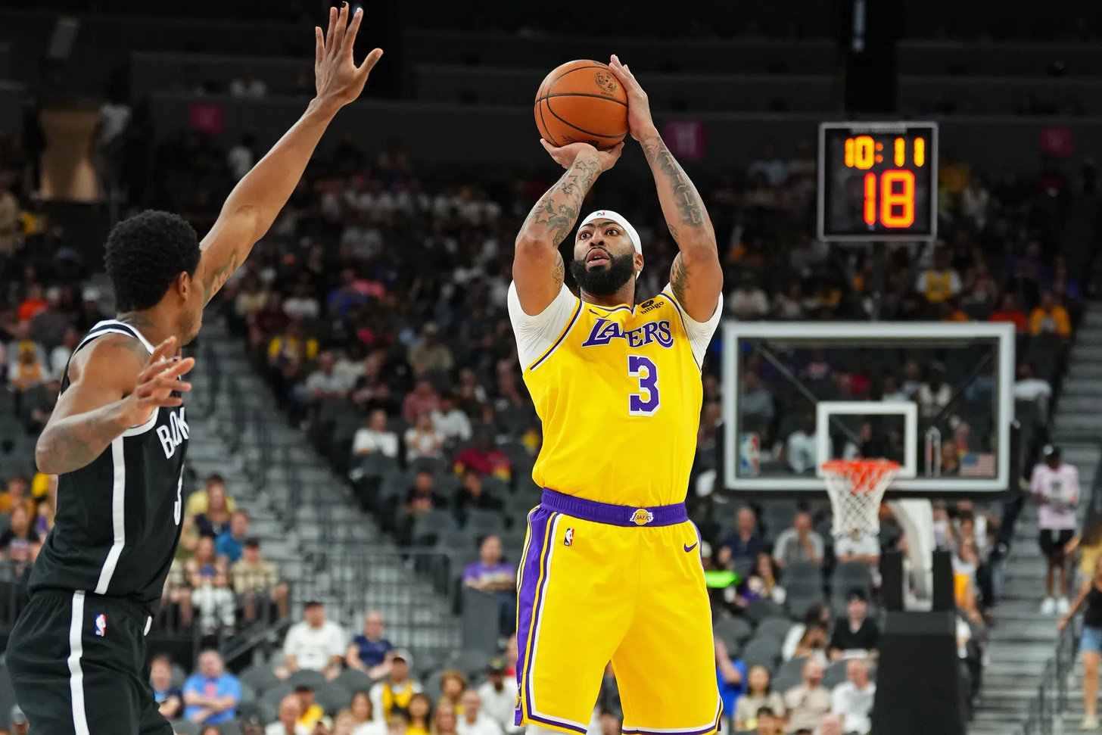
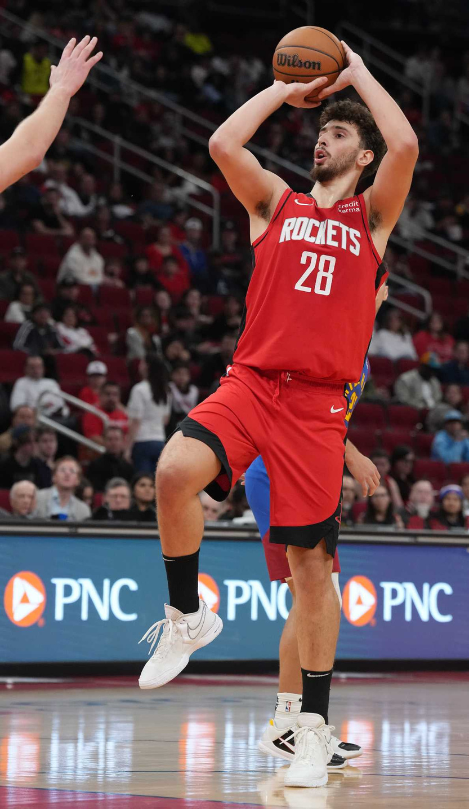
Is the 3 Point Shot Necessary to be a Valuable Player?

Slide 12
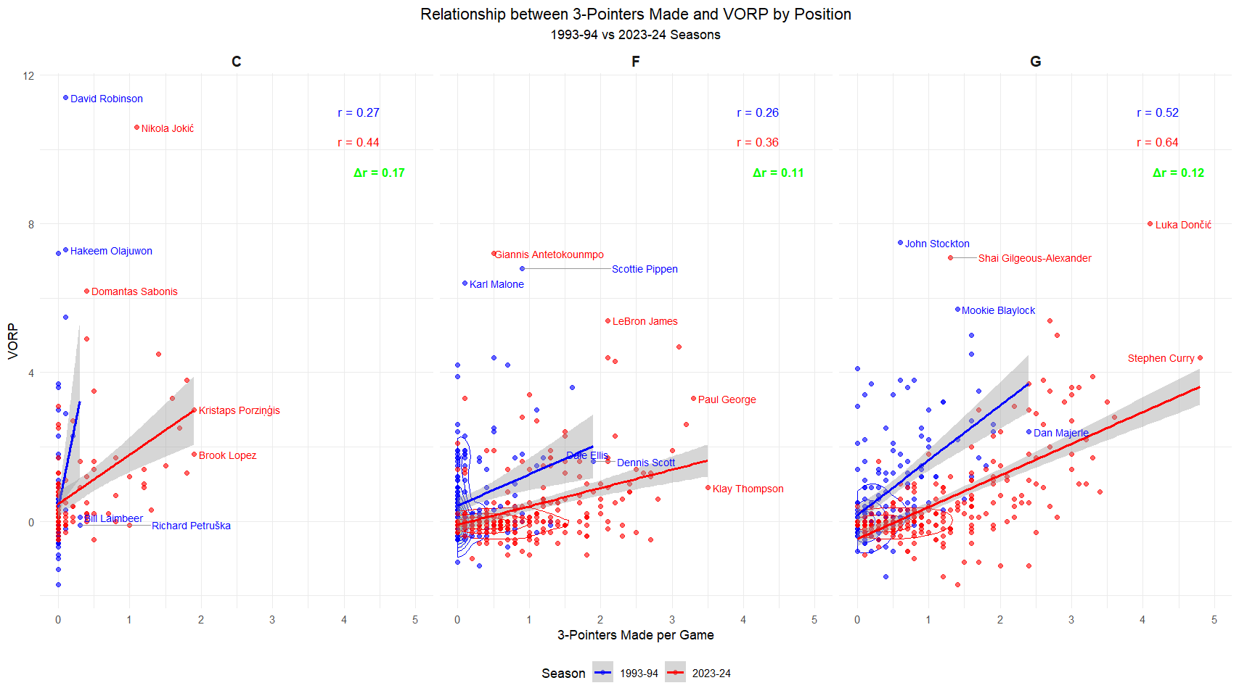
Correlation Between 3PM vs. VORP
3 point making ability affects the value of a player, especially centers, more than before.
93-94 Season
C- r= 0.27
F- r= 0.38
G- r=0.52
23-24 Season
C- r=0.44
F- r=0.38
G- r=0.64

Slide 13
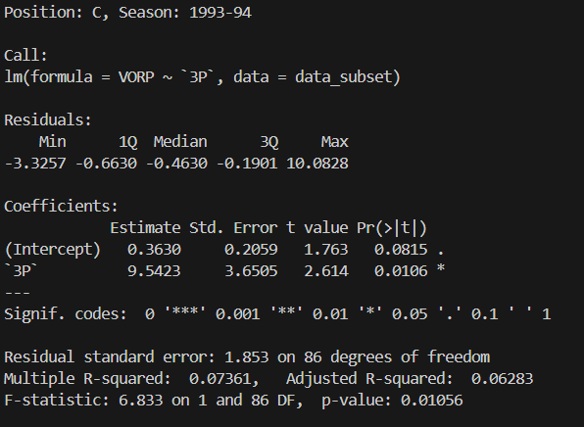
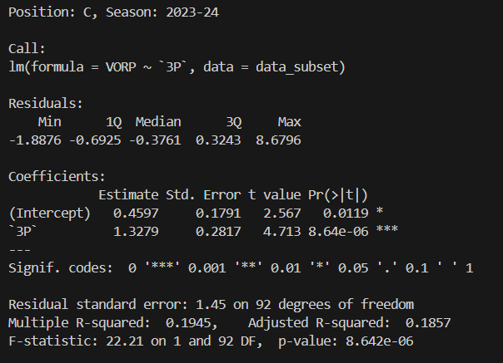
ANOVA Tables For Centers
From the ANOVA table we see an increase in multiple r-squared and F-statistic, with a decrease in residual standard error and p values. Is it enough?

Slide 14
Conclusion: Have the Player Roles Changed?
For point guards and shooting guards: NO
For centers and power forwards: Maybe
Because they are required to do things they did before with a more diverse skillset.
That’s why new player archetypes such as ‘playmaking center’ or ‘shooting big men’ have emerged.

Slide 15

Thank you for your attention.

